Slide 1

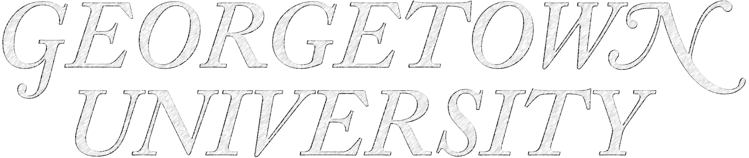

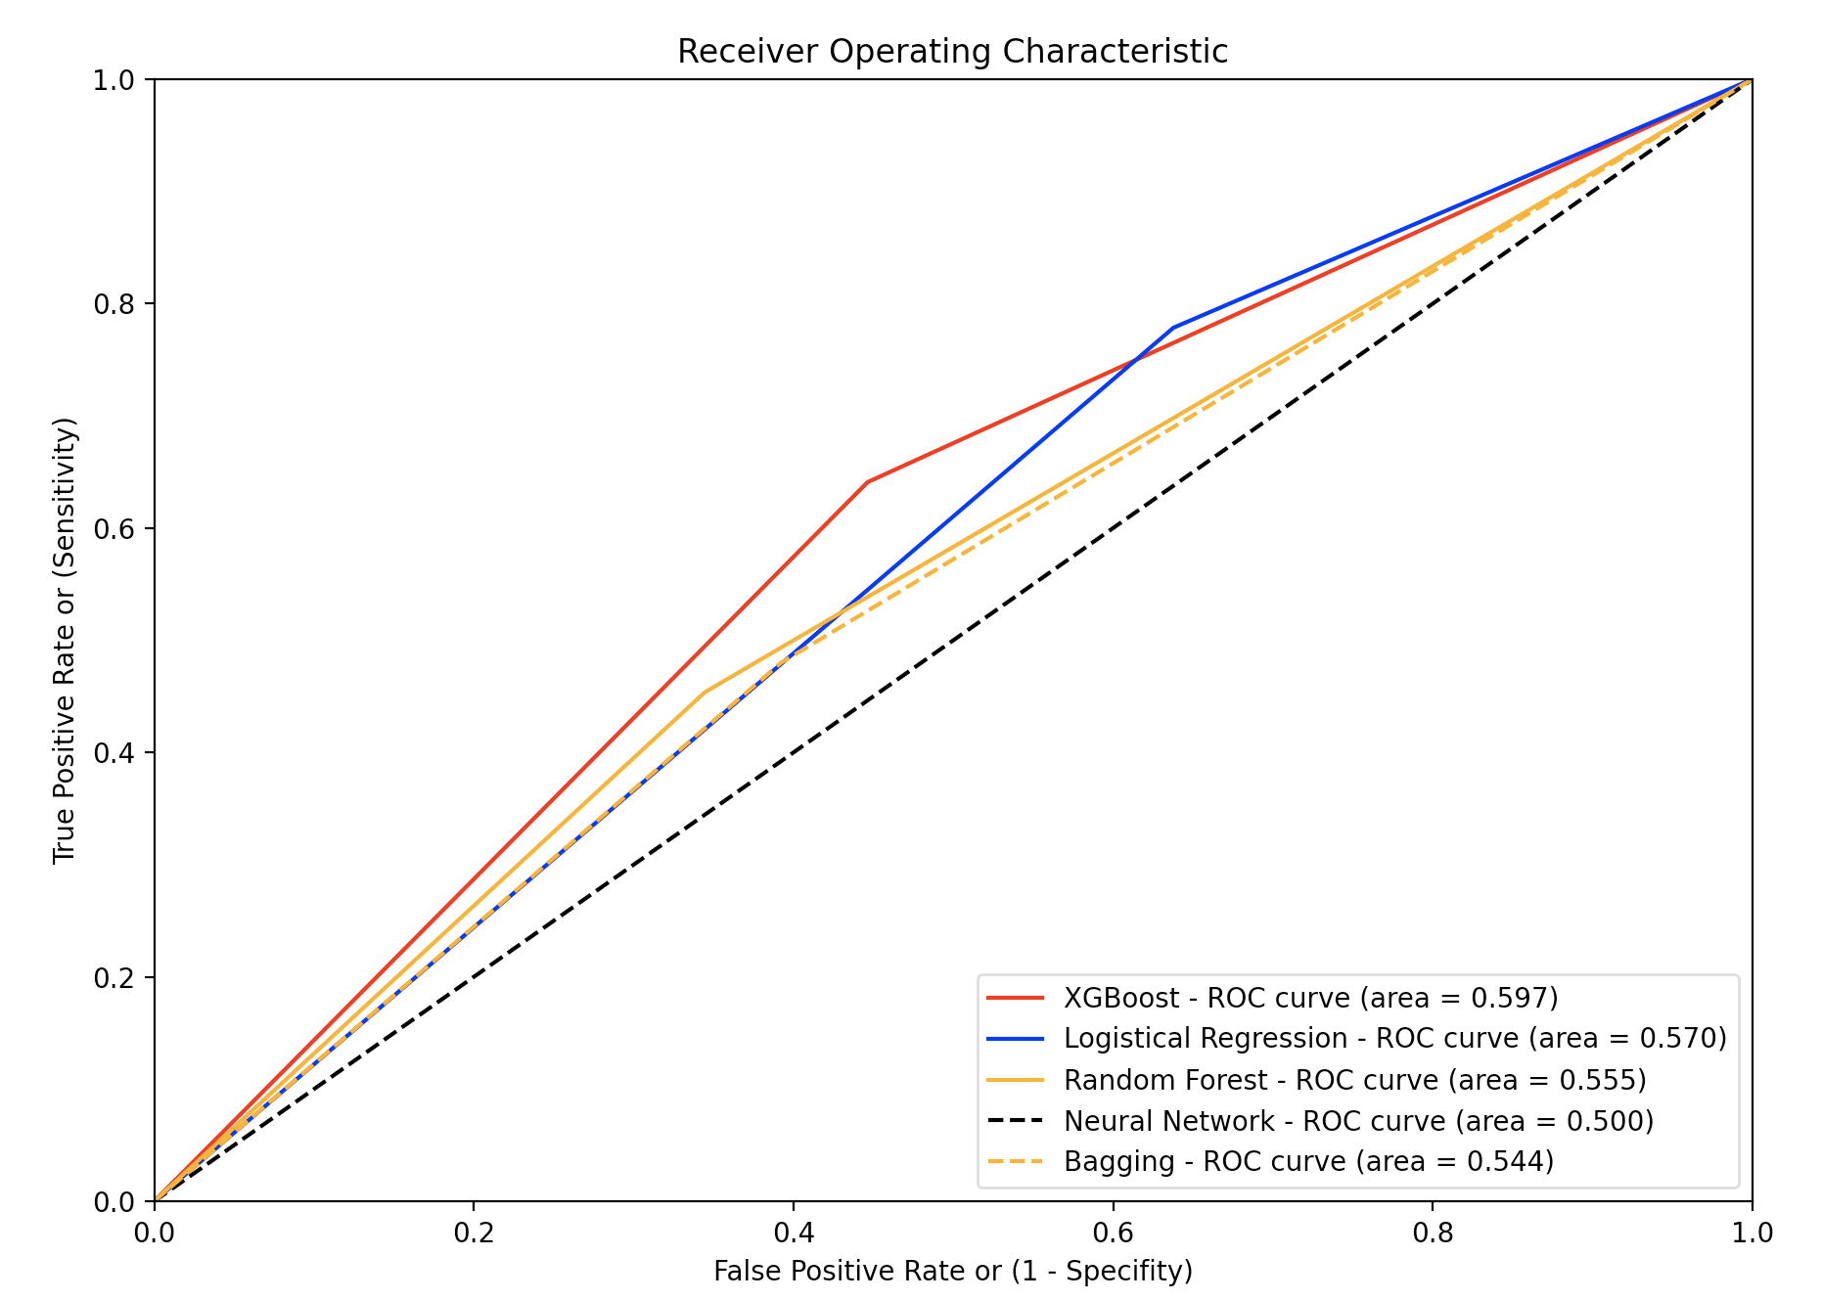
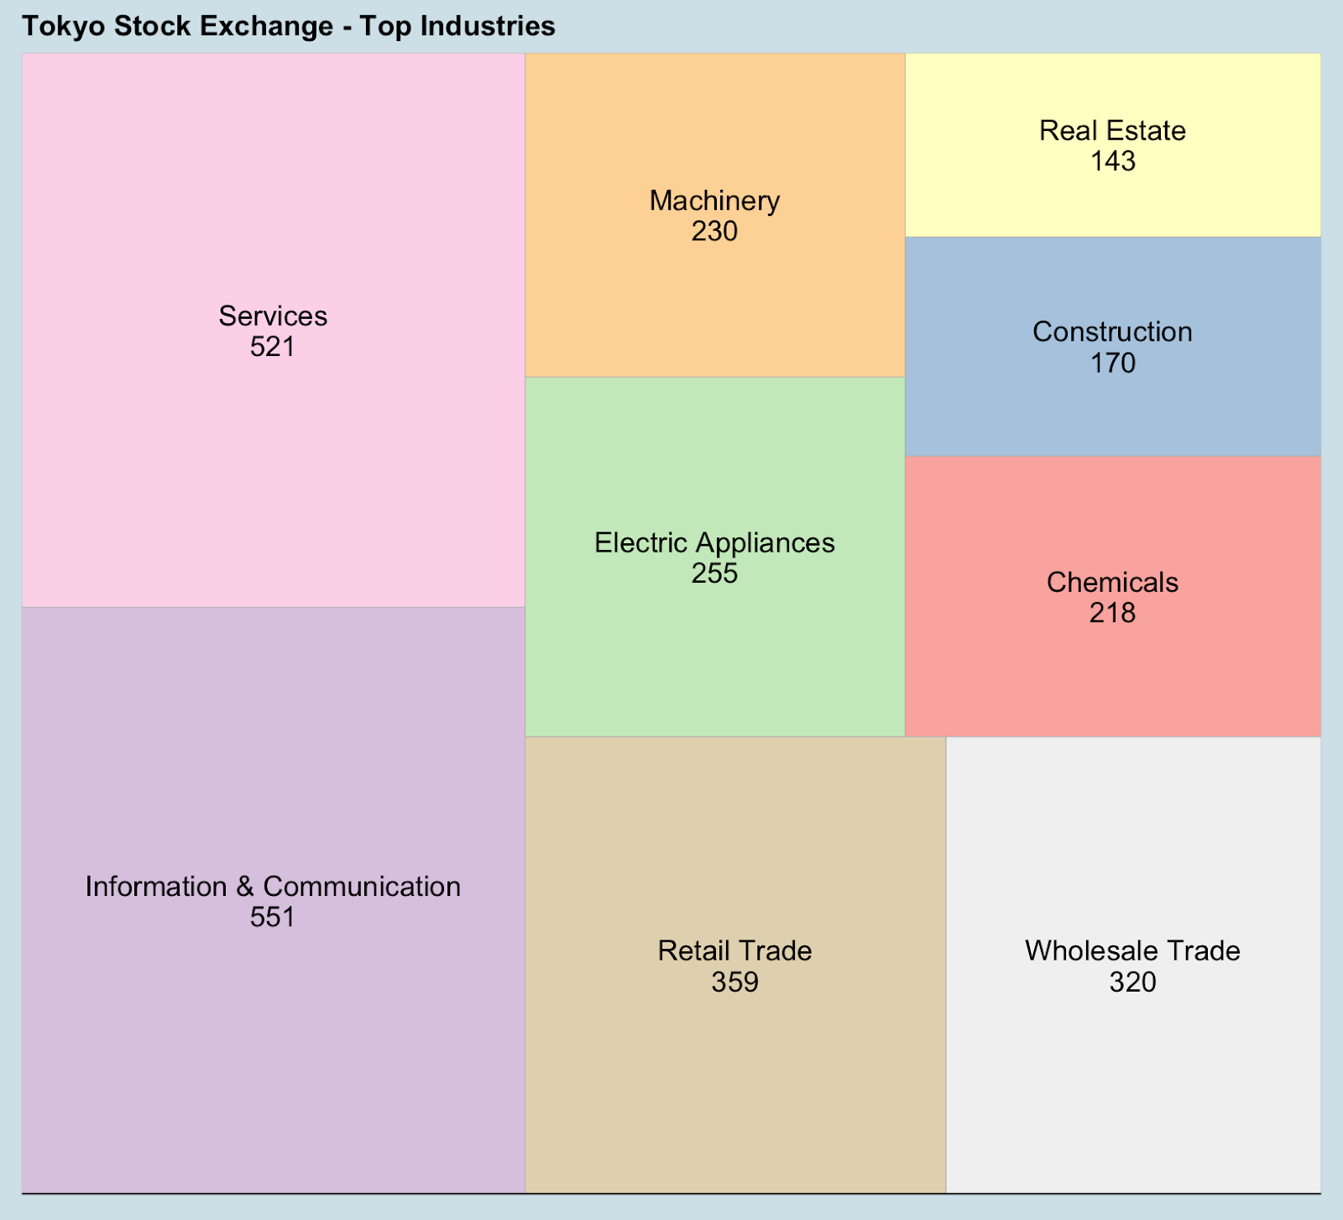
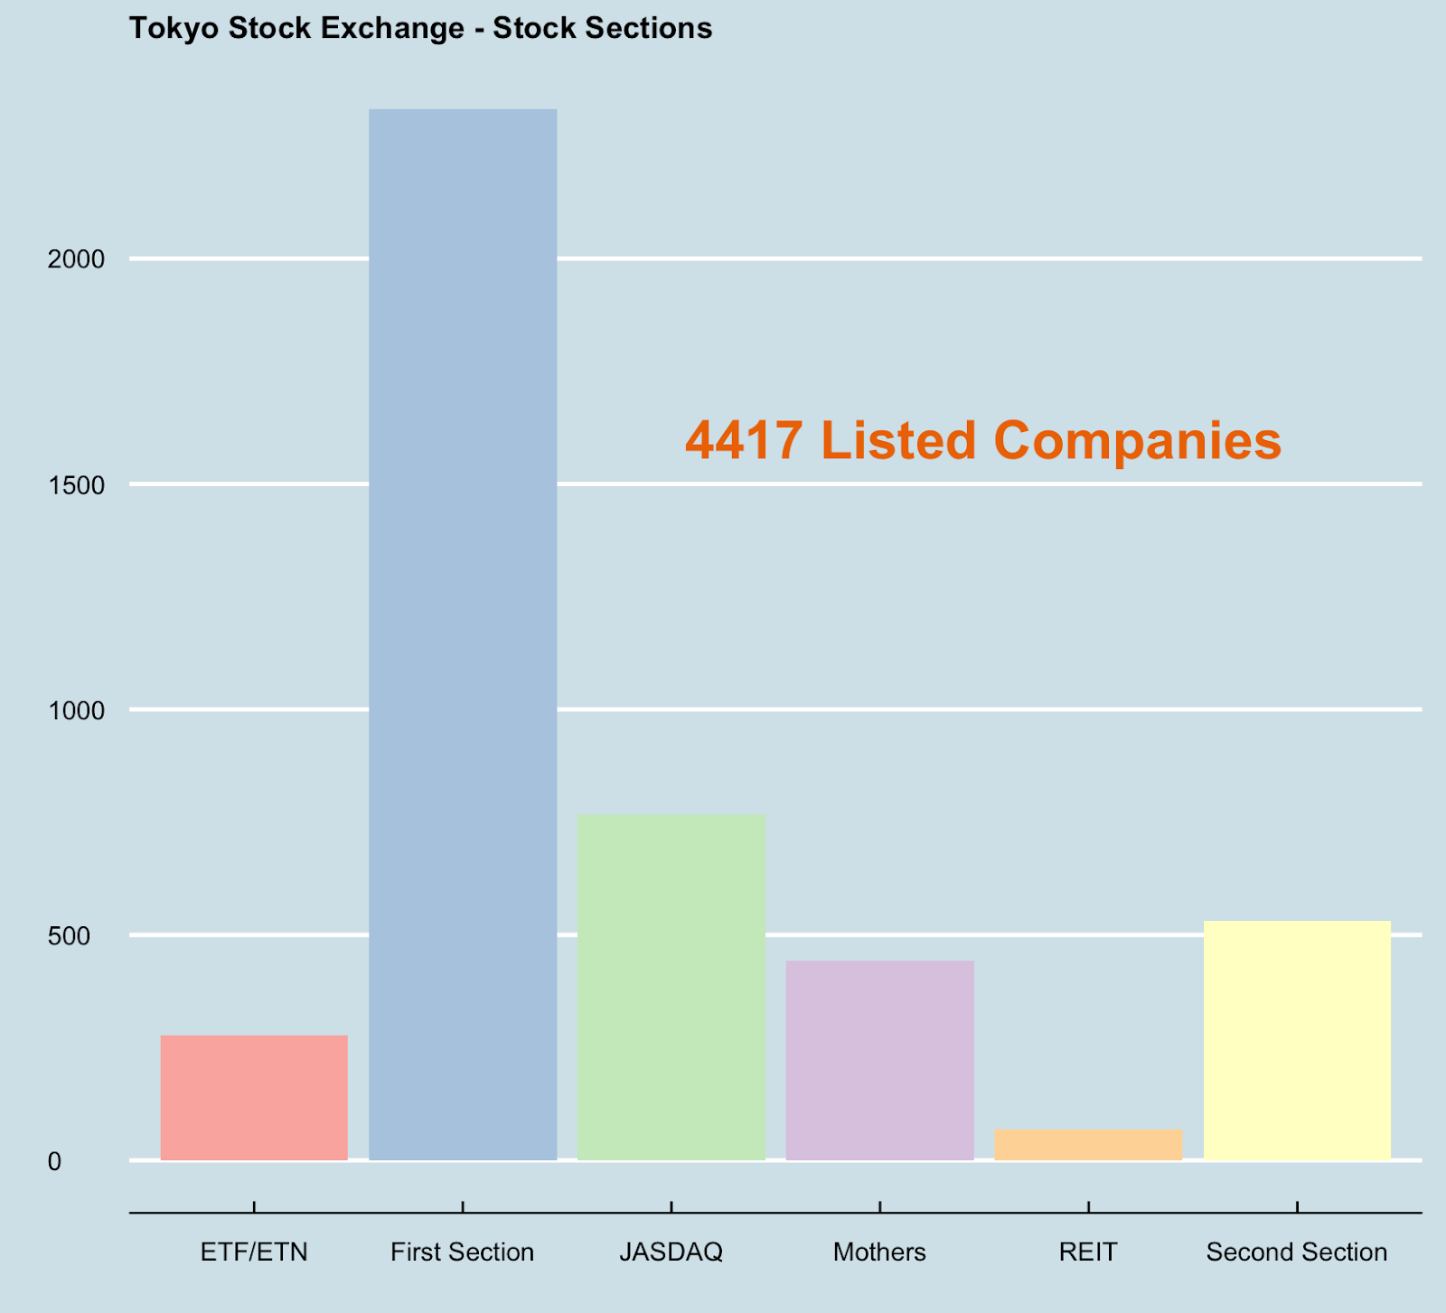
DIAMETER PREDICTION OF ASTEROIDS
JPX Tokyo Stock Exchange Prediction
Ziyun Wang (zw158), Swaminathan Venkateswaran (sv526), Juzer Poonawala (jap369), Prakhar Maheshwari (pm1178)
TEGVEER GHURA, ANTHONY MOUBARAK, RAMDAYAL REWARIA, RAGHAV SHARMA
Author One, MD, PhD; Author Two, MD; Author Three, MD
Introduction
Despite two painful “lost decades,” Japan remains one of the largest economies in the world. It is a nation with advanced technological know-how, a formidable manufacturing base, world-class infrastructure, and a large and affluent consumer market.
Public policy changes can create the right conditions for growth, but most of the outcome resides in the hands of the private sector, therefore we will be looking at the overall stock market data to see whether it is possible to forecast Japan’s tomorrow and what machine learning model performs better in predicting.
Data Science Problems
What machine learning model most accurately predicts the future of Japan's economy amongst all the stocks? How do the models’ accuracy vary between them?
What are the three major industries within the Japanese stock exchange? What machine learning model most accurately predicts if those industries’ stocks will go up or down tomorrow?
Dataset
This project used the JPX stock prices from January 2017 to December 2021 and look closely at close price (i.e., last traded price on a day) and volume (i.e., number of traded stocks on a day) for training and predicting. JPX stock price data set includes 4,417 listed companies.
Methods
XGBoost – It gives a prediction model in the form of an ensemble of weak prediction models, which are typically decision trees.
Logistic Regression – it models the probabilities for classification problems with two possible outcomes, which in our case is up or down for the second day stock close price.
Random Forest – it establishes the outcome based on the predictions of the decision trees and predicts by taking the average or mean of the output from various trees.
Neural Network – a computing system inspired by the biological neural networks that constitute human brains.
Bagging – also called bootstrap aggregating, which creates multiple different models from a single training dataset to improve the stability and accuracy of machine learning algorithms.
Data Exploration
The stock types range from ETFs (similar to mutual funds) to Mothers (the section for only shares of startup companies to list and trade).
Leading industries can spearhead national productivity growth overall, therefore three pillar industries will be assessed in this project: Information & Communication, Services, and Retail trade.
The Information and Communications Technology (ICT) industry in Japan is touted to be the top industry in the country.
The Services industry accounts for approximately 70% of Japan's gross domestic product (GDP) and approximately 75% of employment, so any insights in this industry can have a large impact on Japan's economy. Retail trade industry contributes steadily for more than ten percent to Japan’s GDP. While the wholesale market has been stagnating in recent years, retail sales have been on an upward trend with the food industry representing the largest retail segment.
Results
Whole Economy
The accuracy for predicting (binary; 1 – up, 0 – down) whether the economy of Japan will go up or down is seen below. This was calculated by taking all the stocks within the Japanese Stock Exchange.
The ROC curve (along with the AUC area) is shown below. We can identify which machine learning algorithm most accurately predicts the JPX Stock Exchange as well as compare it to the other methodologies we used.
Top 3 Industries
The accuracy for predicting (binary; 1 – up, 0 – down) whether the top 3 industries within Japan will go up or down is seen below. This was calculated by selecting the 3 most represented industries and taking their respective stocks.
Conclusion
Overall, the second day's overall close prices at JPX Tokyo Stock Exchange and the three pillar industries are simply unpredictable as our accuracy rates stagnated at 50%-ish. However, we still have faith in Japan’s economy as its stock market continues to stay volatile and reacts quickly with policy change and world dynamics.
The coming decade will bring an ongoing wave of innovation in manufacturing all over the world.
The retail sector can make a quantum leap in performance by deploying new technologies, responding to changing demographics, and increasing its efficiency.
There is no doubt that Japan has an alarming aging population problem that is dragging its economy back, therefore it is critical for the Japanese government to take practical measures on how to leverage its reputable pillar industries and to keep up in the global competition.
Limitation / Future Works
The biggest limitation regarding this project is its tunneled scope to only using stocks as well as not incorporating the ”time” aspect in dealing with stocks. The ongoing Kaggle competition provided datasets to include options, securities, secondary stock prices, time of trade, etc. Incorporating these add-ons coupled with more enhanced machine learning models (ex: LightGBM, Gated Recurrent Unit, LSTM, etc.) would yield a more accurate result of predicting Japan’s economy of tomorrow.
References
https://www.kaggle.com/competitions/jpx-tokyo-stock-exchange-prediction/overview
https://xgboost.readthedocs.io/en/stable/python/python_api.html
https://scikit-learn.org/stable/modules/generated/sklearn.linear_model.LogisticRegression.html
https://scikit-learn.org/stable/modules/generated/sklearn.ensemble.RandomForestClassifier.html
https://scikit-learn.org/stable/modules/neural_networks_supervised.html
https://scikit-learn.org/stable/modules/generated/sklearn.ensemble.BaggingClassifier.html
Acknowledgement
We would like to thank Dr. Nakul, Dr. Purna, as well as Georgetown University Graduate School of Arts & Sciences. We would also like to acknowledge the Data Science & Analytics (GSAS) program at Georgetown University.
Machine Learning Model | Accuracy
XG Boost | 0.59689
Logistical Regression | 0.56867
Random Forest | 0.5554
1 Layer Neural Network | 0.50411
Bagging | 0.54437
Table 1 – Machine Learning model vs. Accuracy (all stocks)
TEGVEER GHURA, ANTHONY MOUBARAK, RAMDAYAL REWARIA, RAGHAV SHARMA
Figure 3 – ROC curve for predicting the Japanese Economy via all stocks.
Figure 1 – Tree Map depicting the most represented industries within the Japanese stock exchange.
Machine Learning Model | Information & Communication Accuracy | Retail Trade Accuracy | Services Accuracy
XG Boost | 0.4125 | 0.5125 | 0.54167
Logistical Regression | 0.5083 | 0.475 | 0.55
Random Forest | 0.4375 | 0.4708 | 0.5417
1 Layer Neural Network | 0.5083 | 0.475 | 0.55
Bagging | 0.4708 | 0.45 | 0.5292
Figure 2 – Bar Graph depicting the most represented sectors within the Japanese stock exchange.
Table 2 – Machine Learning model vs. Accuracy (industry specific stocks)

